Slide 1
Chapter 4
File Systems
Tanenbaum, Modern Operating Systems 3 e, (c) 2008 Prentice-Hall, Inc. All rights reserved. 0-13-6006639

Slide 2
File Systems
Many important applications need to store more information then have in virtual address space of a process
The information must survive the termination of the process using it.
Multiple processes must be able to access the information concurrently.
Tanenbaum, Modern Operating Systems 3 e, (c) 2008 Prentice-Hall, Inc. All rights reserved. 0-13-6006639

Slide 3
File Systems
Disks are used to store files
Information is stored in blocks on the disks
Can read and write blocks
Tanenbaum, Modern Operating Systems 3 e, (c) 2008 Prentice-Hall, Inc. All rights reserved. 0-13-6006639

Slide 4
File Systems
Use file system as an abstraction to deal with accessing the information kept in blocks on a disk
Files are created by a process
Thousands of them on a disk
Managed by the OS
Tanenbaum, Modern Operating Systems 3 e, (c) 2008 Prentice-Hall, Inc. All rights reserved. 0-13-6006639

Slide 5
File Systems
OS structures them, names them, protects them
Two ways of looking at file system
  User-how do we name a file, protect it, organize the files
  Implementation-how are they organized on a disk
Start with user, then go to implementer
Tanenbaum, Modern Operating Systems 3 e, (c) 2008 Prentice-Hall, Inc. All rights reserved. 0-13-6006639

Slide 6
File Systems
The user point of view
  Naming
  Structure
  Directories
Tanenbaum, Modern Operating Systems 3 e, (c) 2008 Prentice-Hall, Inc. All rights reserved. 0-13-6006639

Slide 7
Naming
  One to 8 letters in all current OS’s
  Unix, MS-DOS (Fat16) file systems discussed
  Fat (16 and 32) were used in first Windows systems
  Latest Window systems use Native File System
  All OS’s use suffix as part of name
  Unix does not always enforce a meaning for the suffixes
  DOS does enforce a meaning
Tanenbaum, Modern Operating Systems 3 e, (c) 2008 Prentice-Hall, Inc. All rights reserved. 0-13-6006639

Slide 8
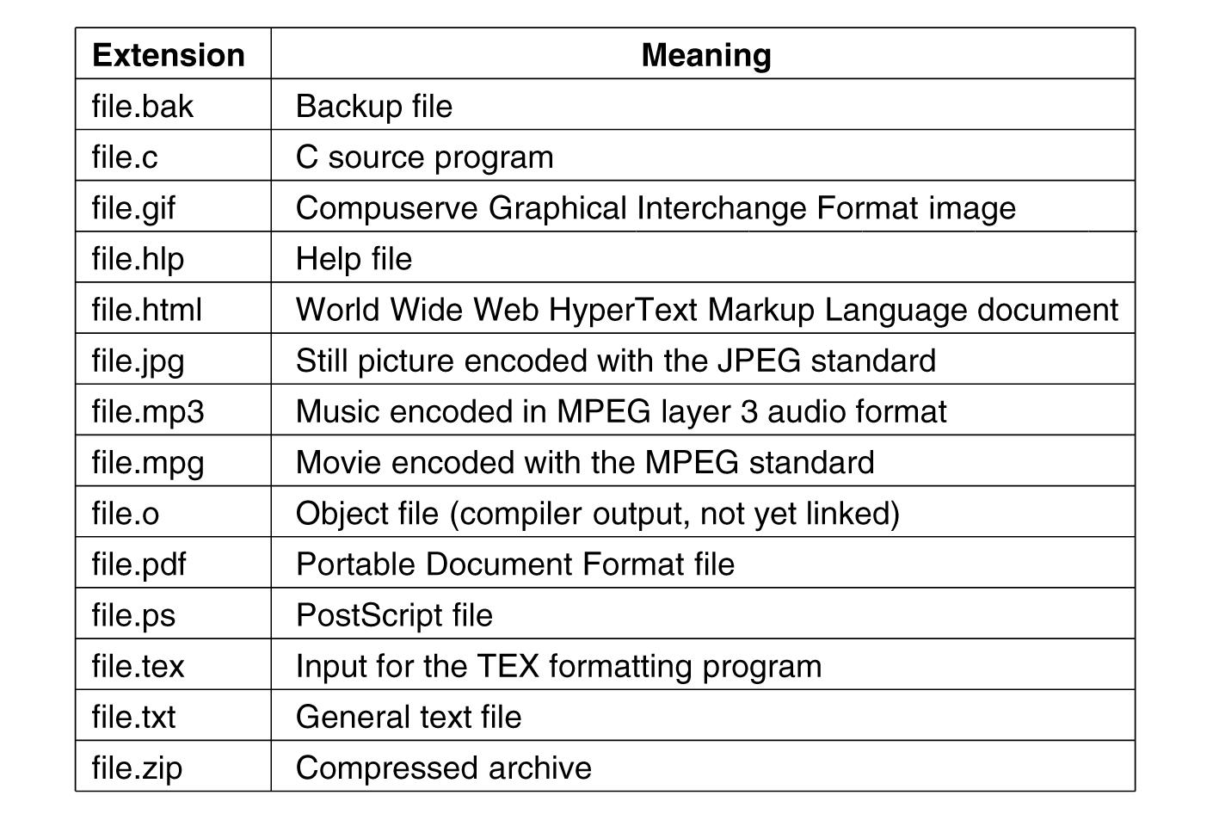
Suffix Examples
.
Tanenbaum, Modern Operating Systems 3 e, (c) 2008 Prentice-Hall, Inc. All rights reserved. 0-13-6006639

Slide 9
File Structure
  Byte sequences
    Maximum flexibility-can put anything in
    Unix and Windows use this approach
  Fixed length records (card images in the old days)
  Tree of records- uses key field to find records in the tree
Tanenbaum, Modern Operating Systems 3 e, (c) 2008 Prentice-Hall, Inc. All rights reserved. 0-13-6006639

Slide 10
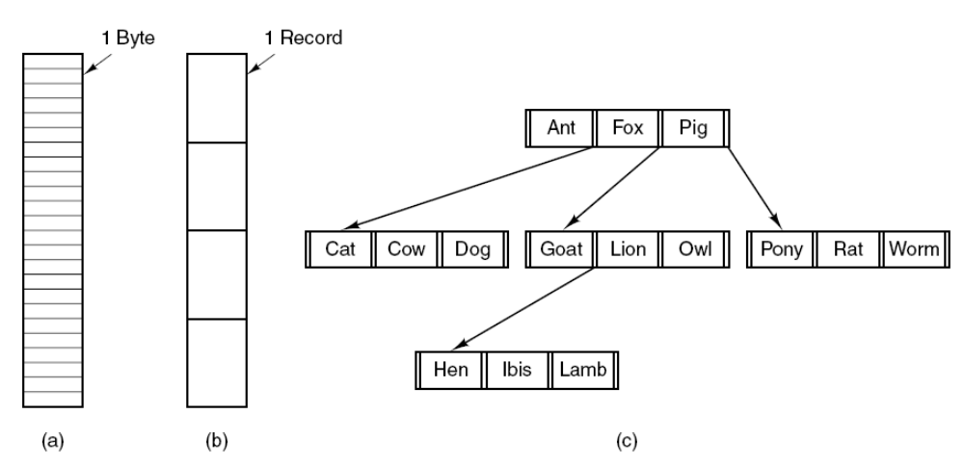
File Structure
Three kinds of files. (a) Byte sequence.
(b) Record sequence. (c) Tree.
Tanenbaum, Modern Operating Systems 3 e, (c) 2008 Prentice-Hall, Inc. All rights reserved. 0-13-6006639

Slide 11
File Types
Regular- contains user information
Directories
Character special files- model serial (e.g. printers) I/O devices
Block special files-model disks
Tanenbaum, Modern Operating Systems 3 e, (c) 2008 Prentice-Hall, Inc. All rights reserved. 0-13-6006639

Slide 12
Regular Files
ASCII or binary
ASCII
  Printable
  Can use pipes to connect programs if they produce/consume ASCII
Tanenbaum, Modern Operating Systems 3 e, (c) 2008 Prentice-Hall, Inc. All rights reserved. 0-13-6006639

Slide 13
Binary File Types
Two Unix examples
  Executable (magic field identifies file as being executable)
  Archive-compiled, not linked library procedures
Every OS must recognize its own executable
Tanenbaum, Modern Operating Systems 3 e, (c) 2008 Prentice-Hall, Inc. All rights reserved. 0-13-6006639

Slide 14
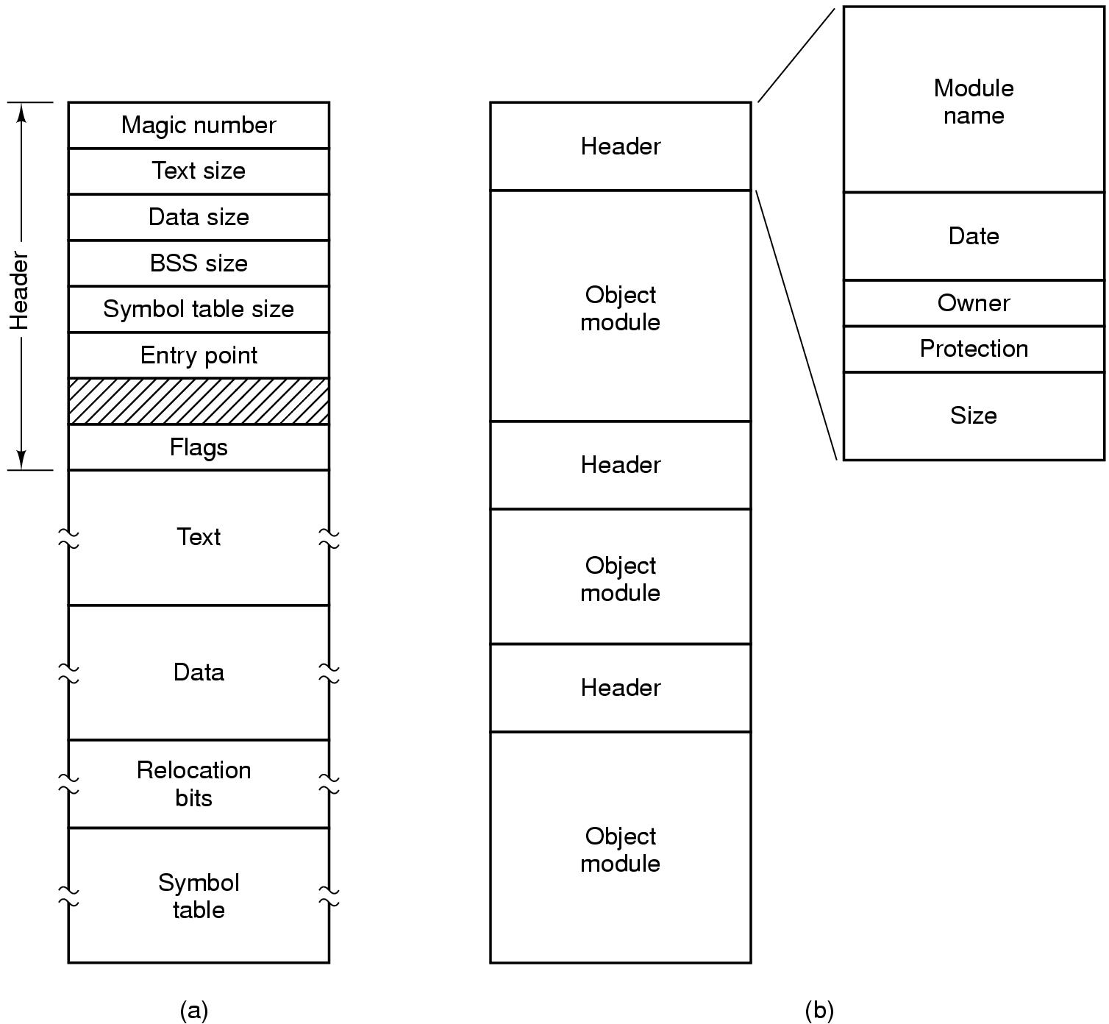
Binary File Types (Early Unix)
(b)An archive-library procedures compiled but not linked
Tanenbaum, Modern Operating Systems 3 e, ©
(a) An executable file (magic # identifiies it as an executable file)

Slide 15
File Access
Sequential access- read from the beginning, can’t skip around
  Corresponds to magnetic tape
Random access- start where you want to start
  Came into play with disks
  Necessary for many applications, e.g. airline reservation system
Tanenbaum, Modern Operating Systems 3 e, (c) 2008 Prentice-Hall, Inc. All rights reserved. 0-13-6006639

Slide 16
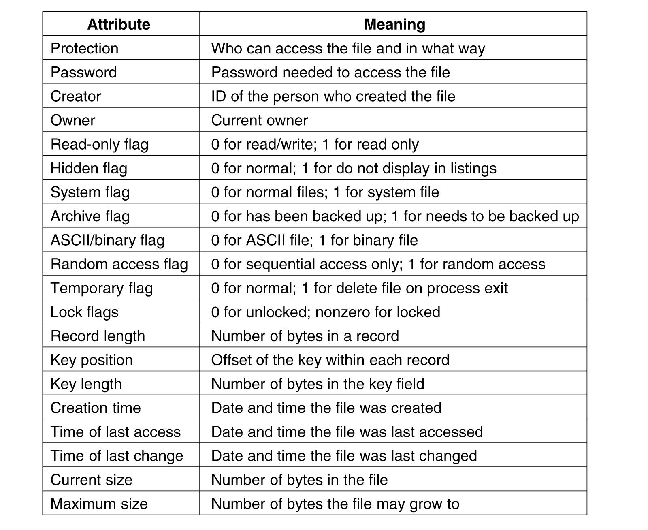
File Attributes (hypothetical OS)
Tanenbaum, Modern Operating Systems 3 e, (c) 2008 Prentice-Hall, Inc. All rights reserved. 0-13-6006639

Slide 17
System Calls for files
:
Create -with no data, sets some attributes
Delete-to free disk space
Open- after create, gets attributes and disk addresses into main memory
Close- frees table space used by attributes and addresses
Read-usually from current pointer position. Need to specify buffer into which data is placed
Write-usually to current position
Tanenbaum, Modern Operating Systems 3 e, (c) 2008 Prentice-Hall, Inc. All rights reserved. 0-13-6006639

Slide 18
System Calls for files
:
Append- at the end of the file
Seek-puts file pointer at specific place in file. Read or write from that position on
Get Attributes-e.g. make needs most recent modification times to arrange for group compilation
Set Attributes-e.g. protection attributes
Rename
Tanenbaum, Modern Operating Systems 3 e, (c) 2008 Prentice-Hall, Inc. All rights reserved. 0-13-6006639

Slide 19
How can system calls be used?
An example-copyfile abc xyz
Copies file abc to xyz
If xyz exists it is over-written
If it does not exist, it is created
Uses system calls (read, write)
Reads and writes in 4K chunks
Read (system call) into a buffer
Write (system call) from buffer to output file
Tanenbaum, Modern Operating Systems 3 e, (c) 2008 Prentice-Hall, Inc. All rights reserved. 0-13-6006639

Slide 20
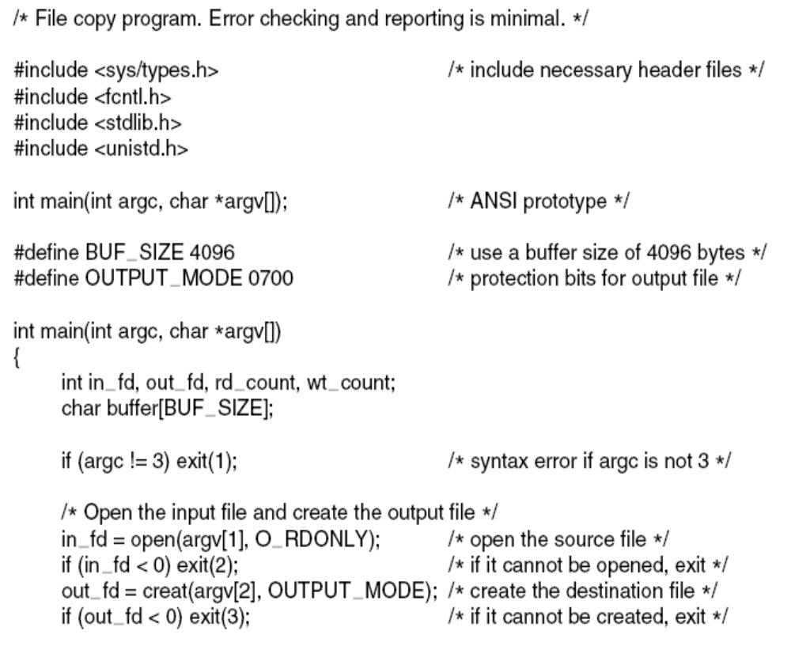
Copyfile abc xyz
. . .
Figure 4-5. A simple program to copy a file.
Tanenbaum, Modern Operating Systems 3 e, (c) 2008 Prentice-Hall, Inc. All rights reserved. 0-13-6006639

Slide 21
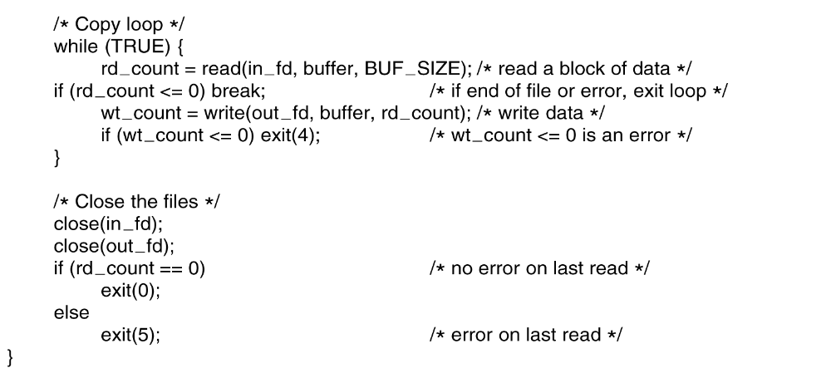
Copyfile abc xyz (2)
.
Tanenbaum, Modern Operating Systems 3 e, (c) 2008 Prentice-Hall, Inc. All rights reserved. 0-13-6006639

Slide 22
Directories
Files which are used to organize a collection of files
  Also called folders in weird OS’s
.
Tanenbaum, Modern Operating Systems 3 e, (c) 2008 Prentice-Hall, Inc. All rights reserved. 0-13-6006639

Slide 23
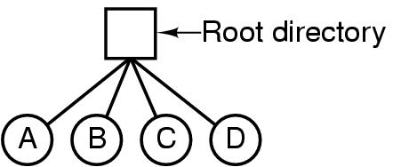
Single Level Directory Systems
A single-level directory system containing four files.
Tanenbaum, Modern Operating Systems 3 e, (c) 2008 Prentice-Hall, Inc. All rights reserved. 0-13-6006639

Slide 24
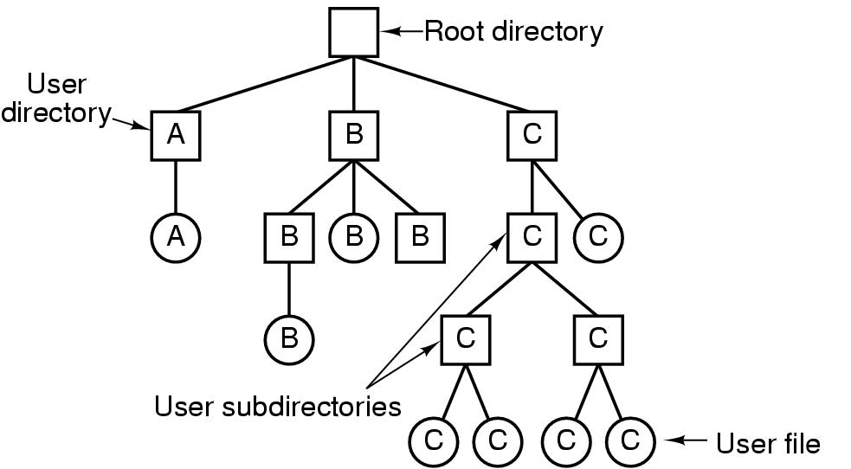
Hierarchical Directory Systems
Tanenbaum, Modern Operating Systems 3 e, (c) 2008 Prentice-Hall, Inc. All rights reserved. 0-13-6006639

Slide 25
Path names
Absolute /usr/carl/cs310/miderm/answers
Relative cs310/midterm/answers
. Refers to current (working) directory
.. Refers to parent of current directory
Tanenbaum, Modern Operating Systems 3 e, (c) 2008 Prentice-Hall, Inc. All rights reserved. 0-13-6006639

Slide 26
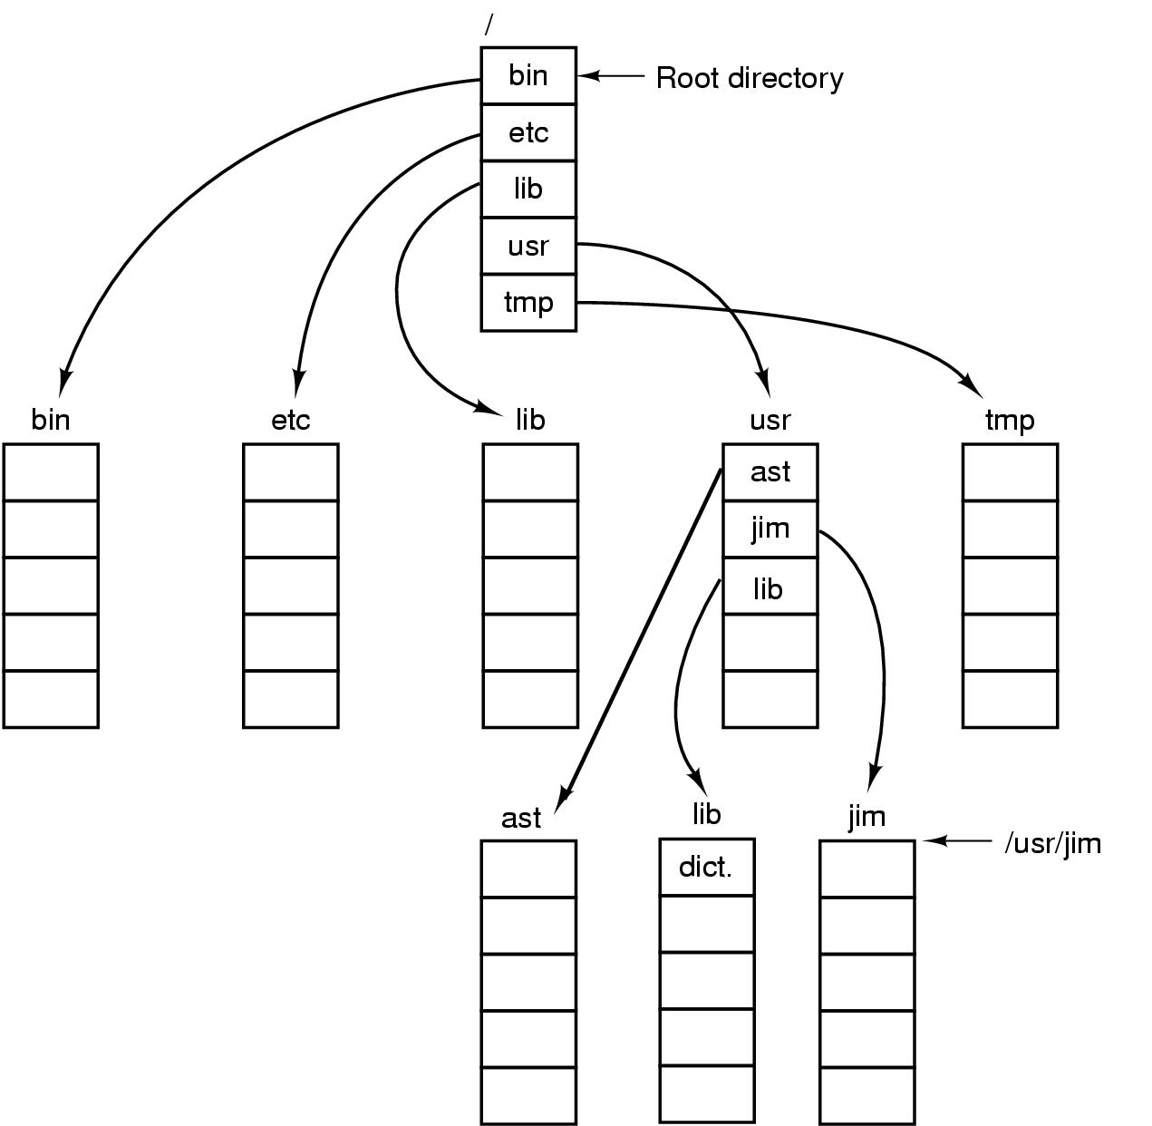
Path Names
A UNIX directory tree.
Tanenbaum, Modern Operating Systems 3 e, (c) 2008 Prentice-Hall, Inc. All rights reserved. 0-13-6006639

Slide 27
Unix cp commands involving dots
Cp ../lib/dictionary .
.. says go to parent (usr)
. says that target of the copy is current directory
cp /usr/lib/dictionary dictionary works
cp /usr/lib/dictionary /usr/ast/dictionary also works
Tanenbaum, Modern Operating Systems 3 e, (c) 2008 Prentice-Hall, Inc. All rights reserved. 0-13-6006639

Slide 28
Directory Operations
Create creates directory
Delete directory has to be empty to delete it
Opendir Must be done before any operations on directory
Closedir
Readdir returns next entry in open directory
Rename
Link links file to another directory
Unlink Gets rid of directory entry
Tanenbaum, Modern Operating Systems 3 e, (c) 2008 Prentice-Hall, Inc. All rights reserved. 0-13-6006639

Slide 29
Directory Operations
System calls for managing directories (from Unix)
Readdir-reads next entry in open directory
Rename
Link-links file to path. File can appear in multiple directories!
Unlink-what it sounds like. Only unlinks from pathname specified in call
Tanenbaum, Modern Operating Systems 3 e, (c) 2008 Prentice-Hall, Inc. All rights reserved. 0-13-6006639

Slide 30
File Implementation
Files stored on disks. Disks broken up into one or more partitions, with separate fs on each partition
Sector 0 of disk is the Master Boot Record
Used to boot the computer
End of MBR has partition table. Has starting and ending addresses of each partition.
One of the partitions is marked active in the master boot table
Tanenbaum, Modern Operating Systems 3 e, (c) 2008 Prentice-Hall, Inc. All rights reserved. 0-13-6006639

Slide 31
File Implementation
Boot computer => BIOS reads/executes MBR
MBR finds active partition and reads in first block (boot block)
Program in boot block locates the OS for that partition and reads it in
All partitions start with a boot block
Tanenbaum, Modern Operating Systems 3 e, (c) 2008 Prentice-Hall, Inc. All rights reserved. 0-13-6006639

Slide 32
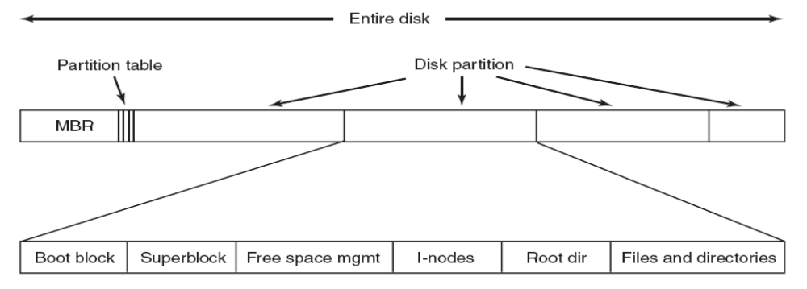
A Possible File System Layout
Tanenbaum, Modern Operating Systems 3 e, (c) 2008 Prentice-Hall, Inc. All rights reserved. 0-13-6006639

Slide 33
File System Layout
Superblock contains info about the fs (e.g. type of fs, number of blocks, …)
i-nodes contain info about files
Tanenbaum, Modern Operating Systems 3 e, (c) 2008 Prentice-Hall, Inc. All rights reserved. 0-13-6006639

Slide 34
Allocating Blocks to files
Most important implementation issue
Methods
  Contiguous allocation
  Linked list allocation
  Linked list using table
  I-nodes
Tanenbaum, Modern Operating Systems 3 e, (c) 2008 Prentice-Hall, Inc. All rights reserved. 0-13-6006639

Slide 35

Contiguous Allocation
(a) Contiguous allocation of disk space for 7 files.
(b) The state of the disk after files D and F have been removed.
Tanenbaum, Modern Operating Systems 3 e, (c) 2008 Prentice-Hall, Inc. All rights reserved. 0-13-6006639

Slide 36
Contiguous Allocation
The good
Easy to implement
Read performance is great. Only need one seek to locate the first block in the file. The rest is easy.
The bad-disk becomes fragmented over time
CD-ROM’s use contiguous allocation because the fs size is known in advance
DVD’s are stored in a few consecutive 1 GB files because standard for DVD only allows a 1 GB file max
Tanenbaum, Modern Operating Systems 3 e, (c) 2008 Prentice-Hall, Inc. All rights reserved. 0-13-6006639

Slide 37

Linked List Allocation
Storing a file as a linked list of disk blocks.
Tanenbaum, Modern Operating Systems 3 e, (c) 2008 Prentice-Hall, Inc. All rights reserved. 0-13-6006639

Slide 38
Linked Lists
The good
Gets rid of fragmentation
The bad
Random access is slow. Need to chase pointers to get to a block
Tanenbaum, Modern Operating Systems 3 e, (c) 2008 Prentice-Hall, Inc. All rights reserved. 0-13-6006639

Slide 39
Linked lists using a table in memory
Put pointers in table in memory
File Allocation Table (FAT)
Windows
Tanenbaum, Modern Operating Systems 3 e, (c) 2008 Prentice-Hall, Inc. All rights reserved. 0-13-6006639

Slide 40
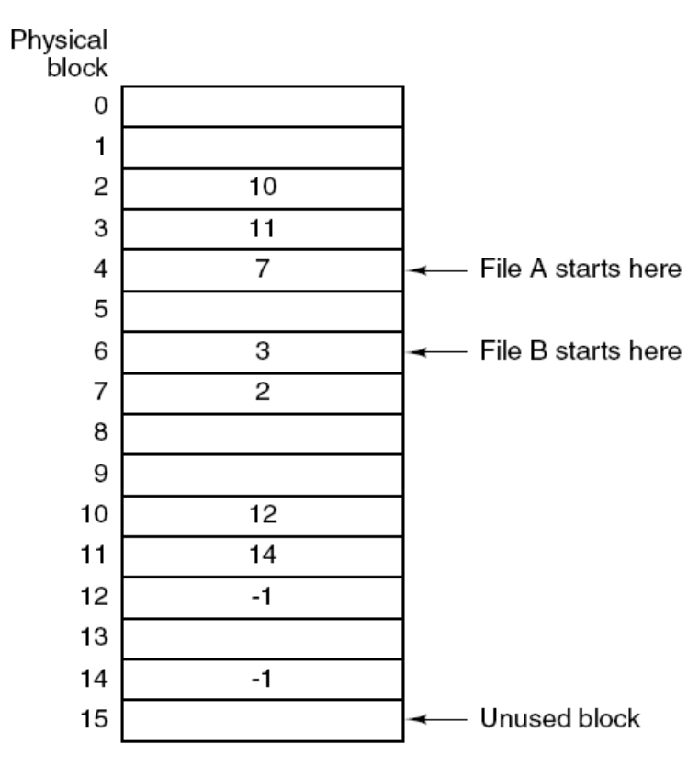
The Solution-Linked List Allocation Using a Table in Memory
Figure 4-12. Linked list allocation using a file allocation table in main memory.
Tanenbaum, Modern Operating Systems 3 e, (c) 2008 Prentice-Hall, Inc. All rights reserved. 0-13-6006639

Slide 41
Linked lists using a table in memory
The bad-table becomes really big
E.g 200 GB disk with 1 KB blocks needs a 600 MB table
Growth of the table size is linear with the growth of the disk size
Tanenbaum, Modern Operating Systems 3 e, (c) 2008 Prentice-Hall, Inc. All rights reserved. 0-13-6006639

Slide 42
I-nodes
Keep data structure in memory only for active files
  Data structure lists disk addresses of the blocks and attributes of the files
K active files, N blocks per file => k*n blocks max!!
Solves the growth problem
Tanenbaum, Modern Operating Systems 3 e, (c) 2008 Prentice-Hall, Inc. All rights reserved. 0-13-6006639

Slide 43
I-nodes
How big is N?
Solution: Last entry in table points to disk block which contains pointers to other disk blocks
Tanenbaum, Modern Operating Systems 3 e, (c) 2008 Prentice-Hall, Inc. All rights reserved. 0-13-6006639

Slide 44
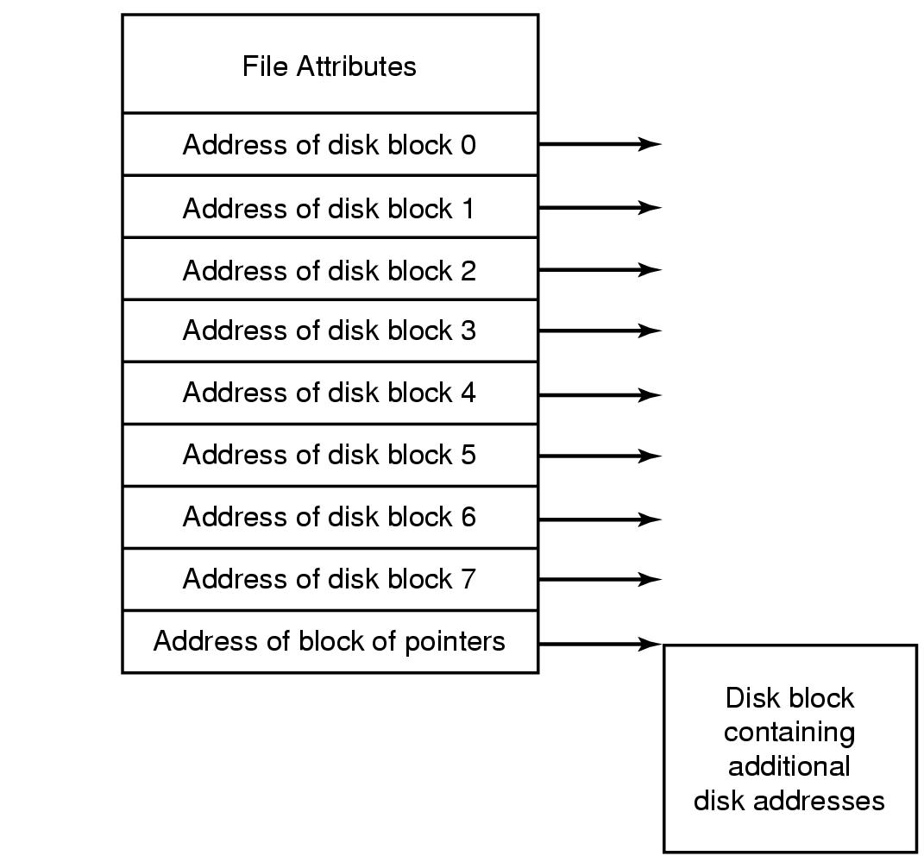
I-nodes
Figure 4-13. An example i-node.
Tanenbaum, Modern Operating Systems 3 e, (c) 2008 Prentice-Hall, Inc. All rights reserved. 0-13-6006639

Slide 45
Implementing Directories
Open file, path name used to locate directory
Directory specifies block addresses by providing
  Address of first block (contiguous)
  Number of first block (linked)
  Number of i-node
Tanenbaum, Modern Operating Systems 3 e, (c) 2008 Prentice-Hall, Inc. All rights reserved. 0-13-6006639

Slide 46
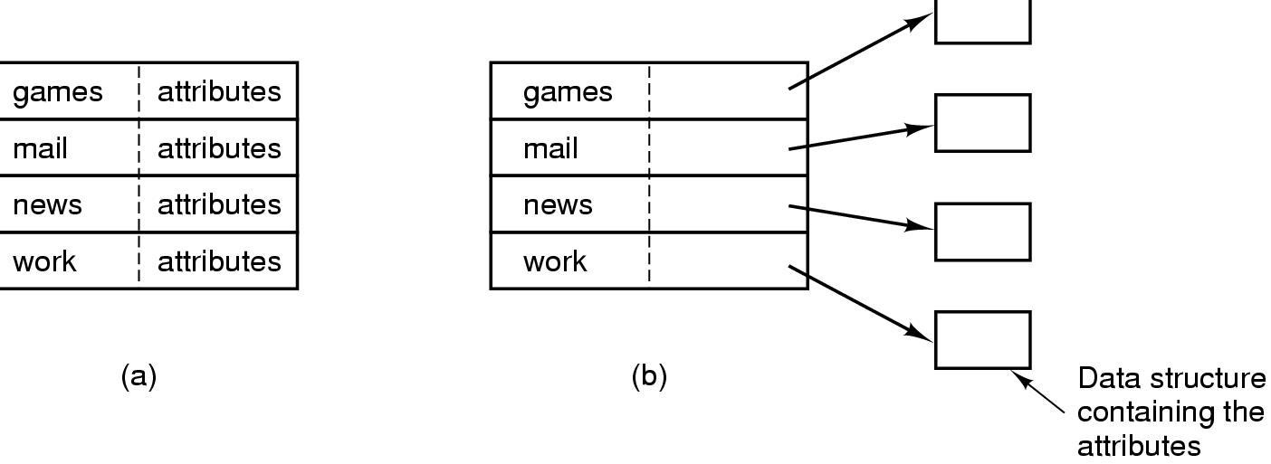
Implementing Directories
(a) fixed-size entries with the disk addresses and attributes (DOS) (b) each entry refers to an i-node. Directory entry contains attributes. (Unix)
Tanenbaum, Modern Operating Systems 3 e, (c) 2008 Prentice-Hall, Inc. All rights reserved. 0-13-6006639

Slide 47
Implementing Directories
How do we deal with variable length names?
Problem is that names have gotten very long
Two approaches
  Fixed header followed by variable length names
  Heap-pointer points to names
Tanenbaum, Modern Operating Systems 3 e, (c) 2008 Prentice-Hall, Inc. All rights reserved. 0-13-6006639

Slide 48
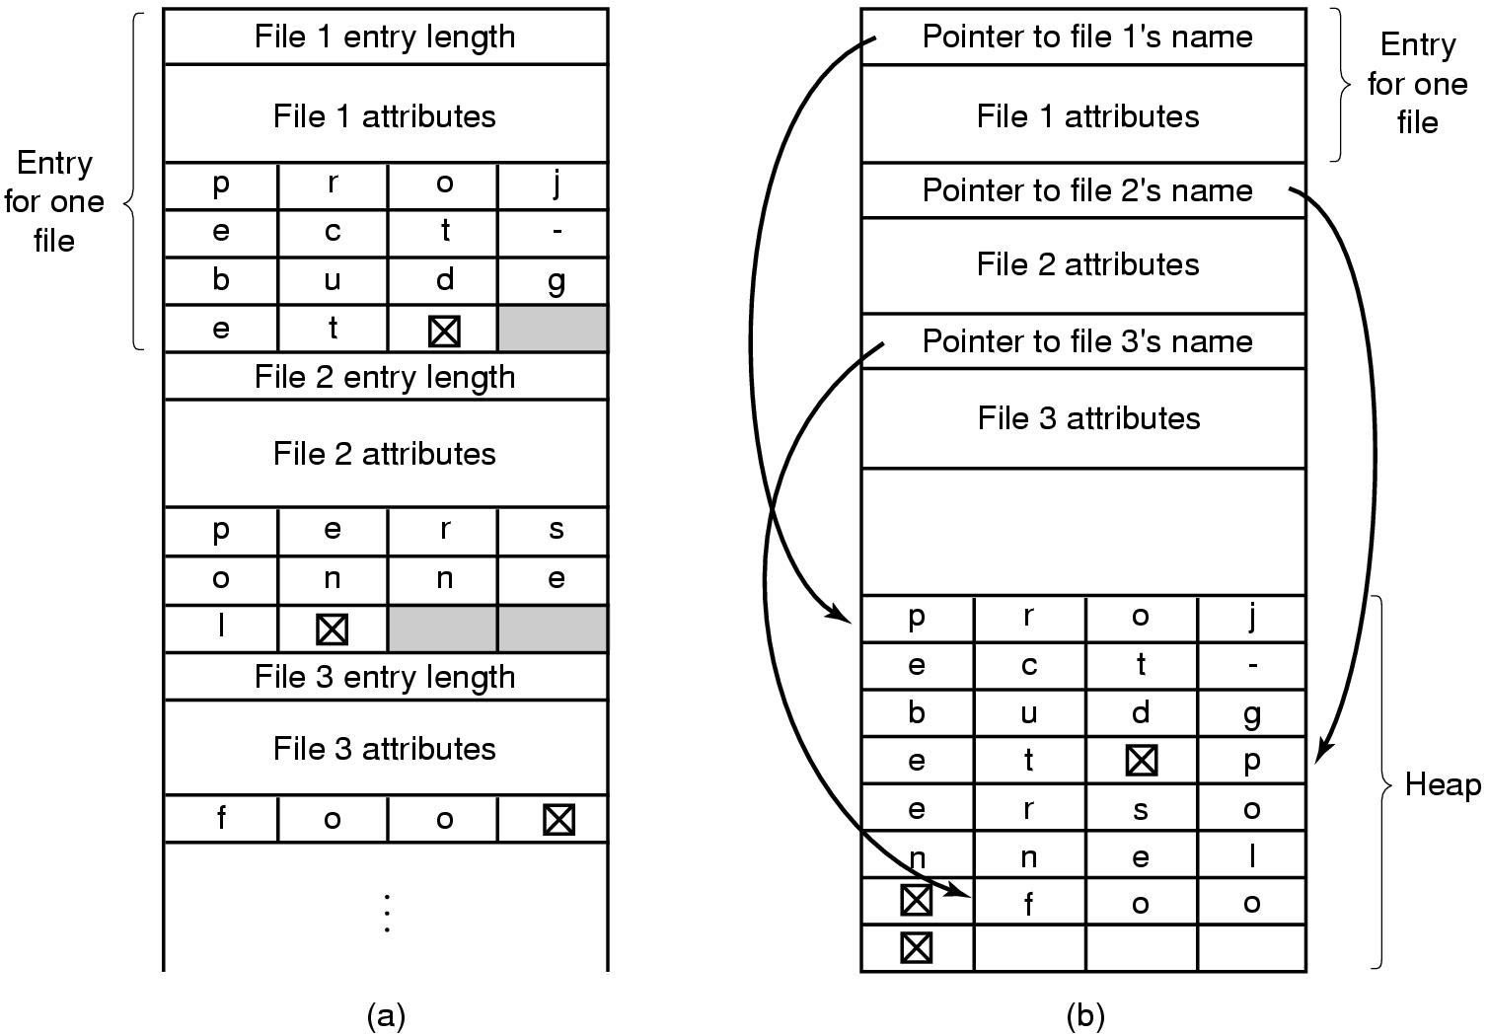
Implementing Directories
Two ways of handling long file names in a directory. (a) In-line. (b) In a heap.
Tanenbaum, Modern Operating Systems 3 e, (c) 2008 Prentice-Hall, Inc. All rights reserved. 0-13-6006639

Slide 49
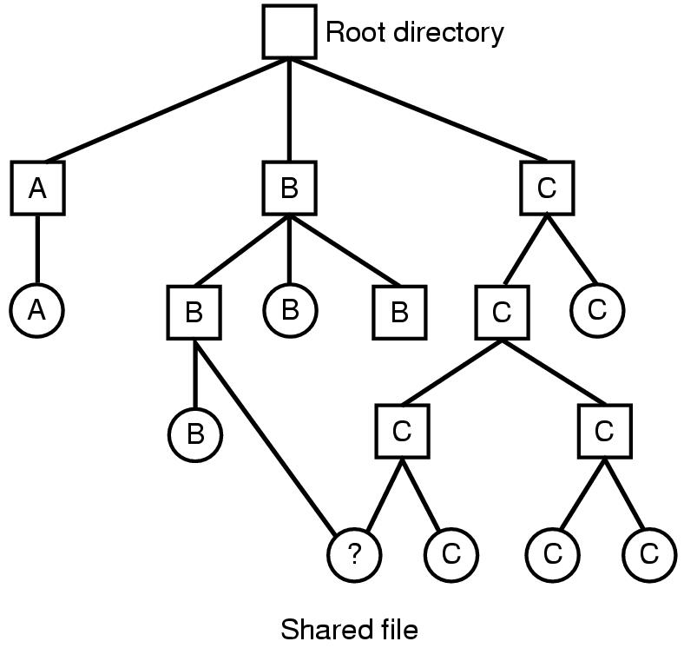
Shared Files
File system containing a shared file. File systems is a directed acyclic tree (DAG)
Tanenbaum, Modern Operating Systems 3 e, (c) 2008 Prentice-Hall, Inc. All rights reserved. 0-13-6006639

Slide 50
Shared files
If B or C adds new blocks, how does other owner find out?
  Use special i-node for shared files-indicates that file is shared
  Use symbolic link - a special file put in B’s directory if C is the owner. Contains the path name of the file to which it is linked
Tanenbaum, Modern Operating Systems 3 e, (c) 2008 Prentice-Hall, Inc. All rights reserved. 0-13-6006639

Slide 51
I-node problem
If C removes file, B’s directory still points to i-node for shared file
If i-node is re-used for another file, B’s entry points to wrong i-node
Solution is to leave i-node and reduce number of owners
Tanenbaum, Modern Operating Systems 3 e, (c) 2008 Prentice-Hall, Inc. All rights reserved. 0-13-6006639

Slide 52
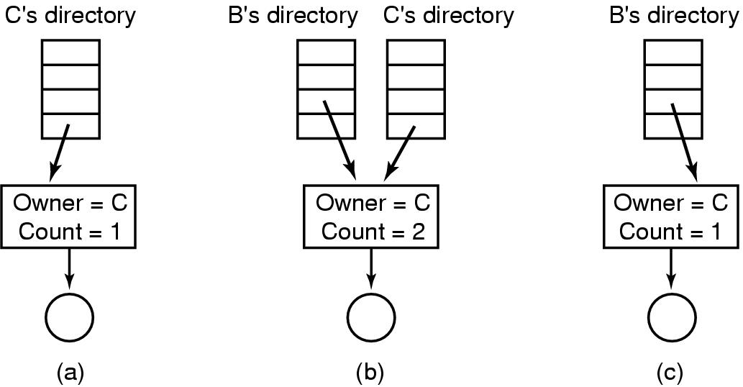
I node problem and solution
(a) Situation prior to linking. (b) After the link is created. (c) After the original owner removes the file.
Tanenbaum, Modern Operating Systems 3 e, (c) 2008 Prentice-Hall, Inc. All rights reserved. 0-13-6006639

Slide 53
Symbolic links
Symbolic link solves problem
Can have too many symbolic links and they take time to follow
Big advantage-can point to files on other machines
Tanenbaum, Modern Operating Systems 3 e, (c) 2008 Prentice-Hall, Inc. All rights reserved. 0-13-6006639

Slide 54
Log Structured File System
CPU’s faster, disks and memories bigger (much) but disk seek time has not decreased
Caches bigger-can do reads from cache
Want to optimize writes because disk needs to be updated
Structure disk as a log-collect writes and periodically send them to a segment in the disk . Writes tend to be very small
Segment has summary of contents (i-nodes, directories….).
Keep i-node map on disk and cache it in memory to locate i-nodes
Tanenbaum, Modern Operating Systems 3 e, (c) 2008 Prentice-Hall, Inc. All rights reserved. 0-13-6006639

Slide 55
Log Structured File System
Cleaner thread compacts log. Scans segment for current i-nodes, discarding ones not in use and sending current ones to memory.
Writer thread writes current ones out into new segment.
Works well in Unix. Not compatible with most file systems
Not used
Tanenbaum, Modern Operating Systems 3 e, (c) 2008 Prentice-Hall, Inc. All rights reserved. 0-13-6006639

Slide 56
Journaling File Systems
Want to guard against lost files when there are crashes. Consider what happens when a file has to be removed.
Remove the file from its directory.
Release the i-node to the pool of free i-nodes.
Return all the disk blocks to the pool of free disk blocks
If there is a crash somewhere in this process, have a mess.
Tanenbaum, Modern Operating Systems 3 e, (c) 2008 Prentice-Hall, Inc. All rights reserved. 0-13-6006639

Slide 57
Journaling File Systems
Keep a journal (i,.e. list) of actions before you take them, write journal to disk, then perform actions. Can recover from a crash!
Need to make operations idempotent. Must arrange data structures to do so.
  Mark block n as free is an idempotent operation.
  Adding freed blocks to the end of a list is not idempotent
  NTFS (Windows) and Linux use journaling
Tanenbaum, Modern Operating Systems 3 e, (c) 2008 Prentice-Hall, Inc. All rights reserved. 0-13-6006639

Slide 58
Virtual File Systems
Have multiple fs on same machine
Windows specifies fs (drives)
Unix integrates into VFS
  Vfs calls from user
  Lower calls to actual fs
Supports Network File System-file can be on a remote machine
Tanenbaum, Modern Operating Systems 3 e, (c) 2008 Prentice-Hall, Inc. All rights reserved. 0-13-6006639

Slide 59
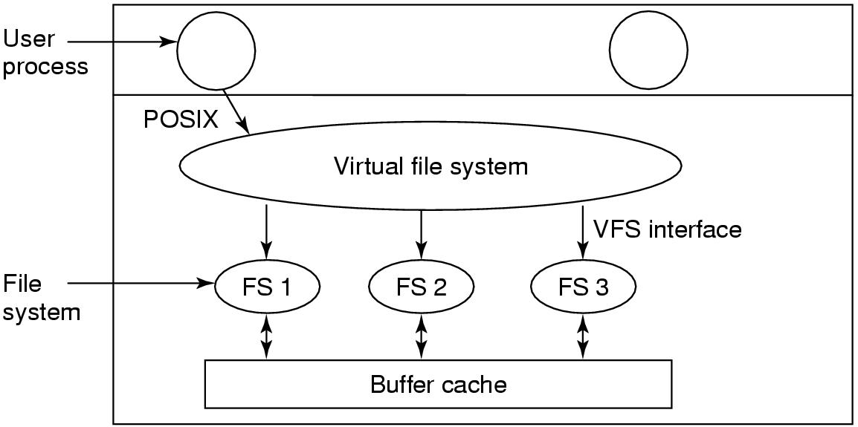
Virtual File Systems (1)
Tanenbaum, Modern Operating Systems 3 e, (c) 2008 Prentice-Hall, Inc. All rights reserved. 0-13-6006639

Slide 60
VFS-how it works
File system registers with VFS (e.g. at boot time)
At registration time, fs provides list of addresses of function calls the vfs wants
Vfs gets info from the new fs i-node and puts it in a v-node
Makes entry in fd table for process
When process issues a call (e.g. read), function pointers point to concrete function calls
Tanenbaum, Modern Operating Systems 3 e, (c) 2008 Prentice-Hall, Inc. All rights reserved. 0-13-6006639

Slide 61
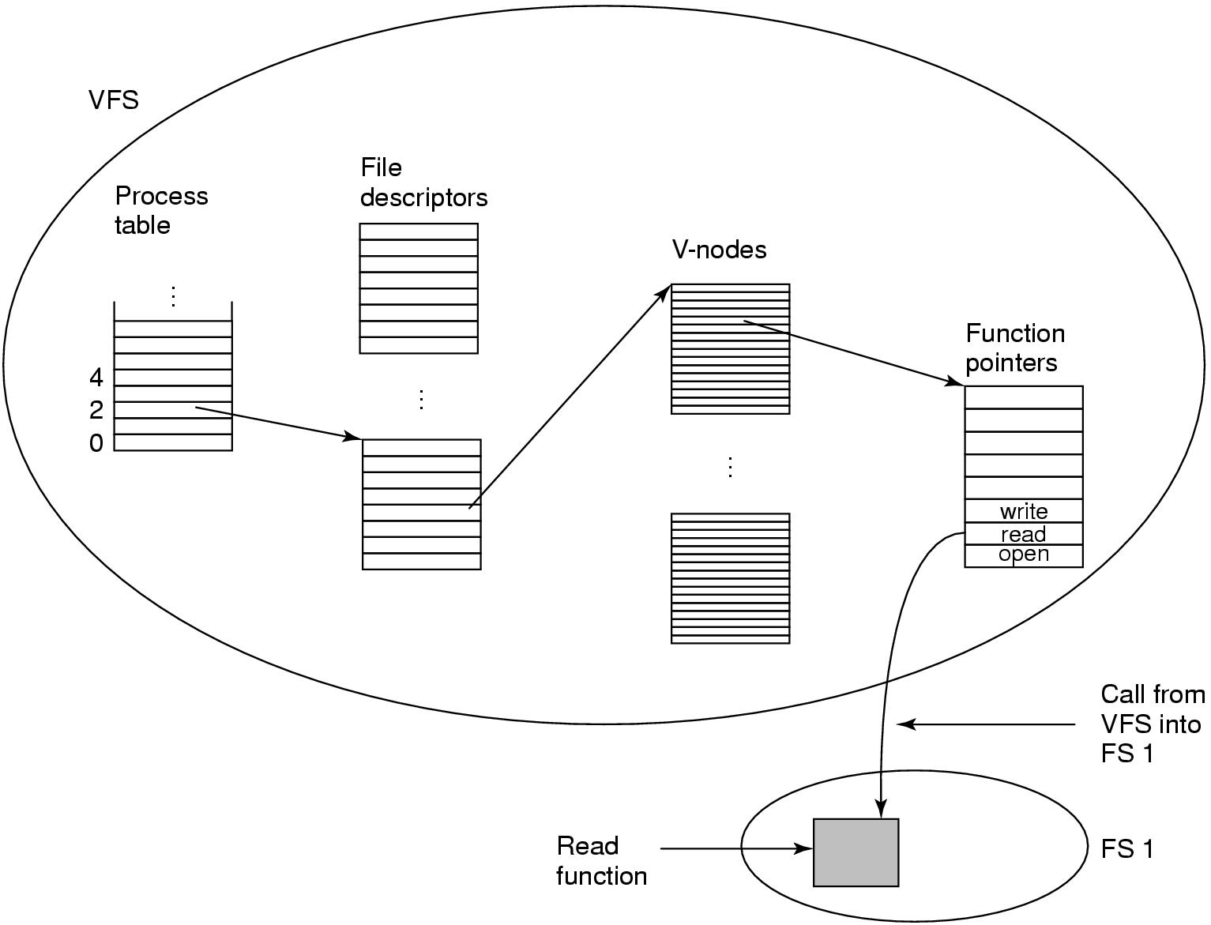
Virtual File Systems
. A simplified view of the data structures and code used by the VFS and concrete file system to do a read.
Tanenbaum, Modern Operating Systems 3 e, (c) 2008 Prentice-Hall, Inc. All rights reserved. 0-13-6006639

Slide 62
File System Management and Optimization-the dirty work
Disk space management
File System Backups
File System Consistency
File System Performance
Tanenbaum, Modern Operating Systems 3 e, (c) 2008 Prentice-Hall, Inc. All rights reserved. 0-13-6006639

Slide 63
Disk Space Management
Disk space management-use fixed size blocks which don’t have to be adjacent
  If stored as consecutive bytes and file grows it will have to be moved
What is optimum (good) block size? Need information on file size distribution.
  Don’t have it when building fs.
Tanenbaum, Modern Operating Systems 3 e, (c) 2008 Prentice-Hall, Inc. All rights reserved. 0-13-6006639

Slide 64
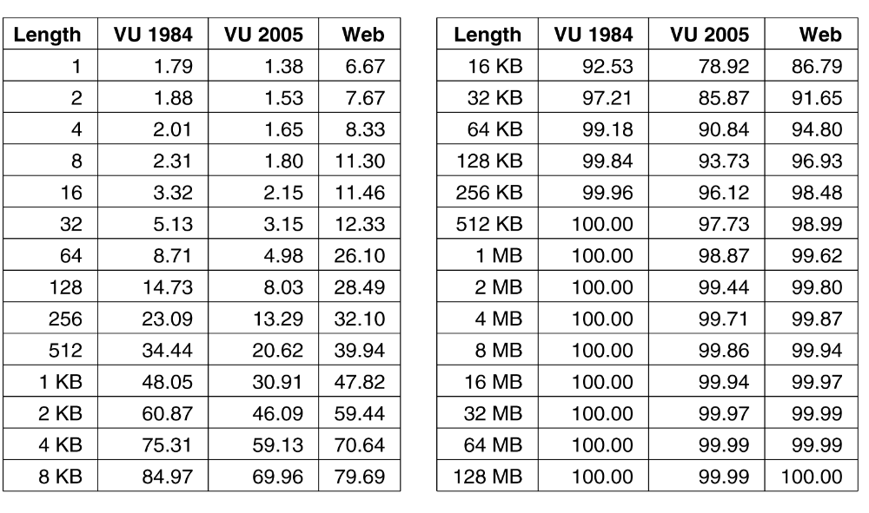
Disk Space Management Block Size (1)
Figure 4-20. Percentage of files smaller than a given size
(in bytes).
Tanenbaum, Modern Operating Systems 3 e, (c) 2008 Prentice-Hall, Inc. All rights reserved. 0-13-6006639

Slide 65
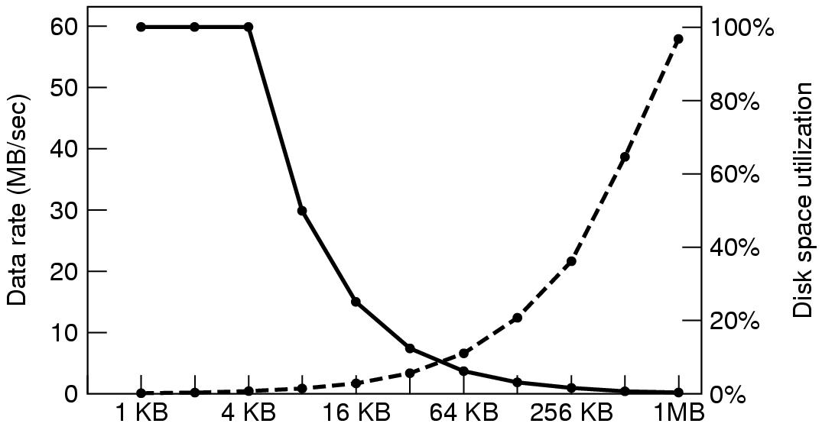
Disk Space Management Block Size (2)
Figure 4-21. The solid curve (left-hand scale) gives the data rate of a disk. The dashed curve (right-hand scale) gives the disk space efficiency. All files are 4 KB.
Tanenbaum, Modern Operating Systems 3 e, (c) 2008 Prentice-Hall, Inc. All rights reserved. 0-13-6006639

Slide 66
Disk Space Management
Bigger block size results in better space utilization, but worse transfer utilization
trade-off is space vs data rate
There is no good answer (Nature wins this time)
Might as well use large (64 KB) block size as disks are getting much bigger and stop thinking about it
Tanenbaum, Modern Operating Systems 3 e, (c) 2008 Prentice-Hall, Inc. All rights reserved. 0-13-6006639

Slide 67
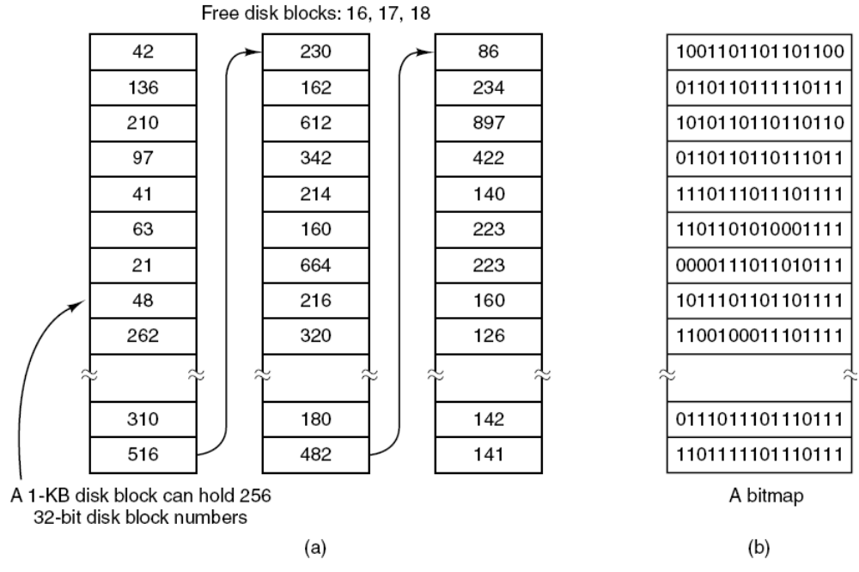
Keeping Track of Free Blocks (1)
Figure 4-22. (a) Storing the free list on a linked list. (b) A bitmap.
Tanenbaum, Modern Operating Systems 3 e, (c) 2008 Prentice-Hall, Inc. All rights reserved. 0-13-6006639

Slide 68
How to keep track of free blocks
Links-need ~1.9 million blocks
Bit-map~need 60,000 blocks
If free blocks come in runs, could keep track of beginning and block and run length. Need nature to cooperate for this to work.
Only need one block of pointers in main memory at a time. Fills up=>go get another
Tanenbaum, Modern Operating Systems 3 e, (c) 2008 Prentice-Hall, Inc. All rights reserved. 0-13-6006639

Slide 69
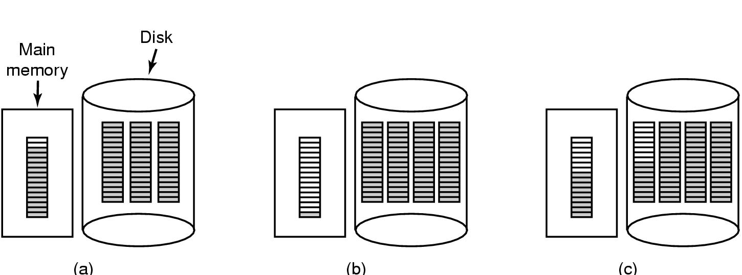
Keeping Track of Free Blocks (2)
Figure 4-23. (a) An almost-full block of pointers to free disk blocks in memory and three blocks of pointers on disk. (b) Result of freeing a three-block file. (c) An alternative strategy for handling the three free blocks. The shaded entries represent pointers to free disk blocks.
Tanenbaum, Modern Operating Systems 3 e, (c) 2008 Prentice-Hall, Inc. All rights reserved. 0-13-6006639

Slide 70
Disk Quotas-you can’t have it all
Entry in open file table points to quota table
One entry for each open file
Places limits (soft, hard) on users disk quota
Illustration on next slide
Tanenbaum, Modern Operating Systems 3 e, (c) 2008 Prentice-Hall, Inc. All rights reserved. 0-13-6006639

Slide 71
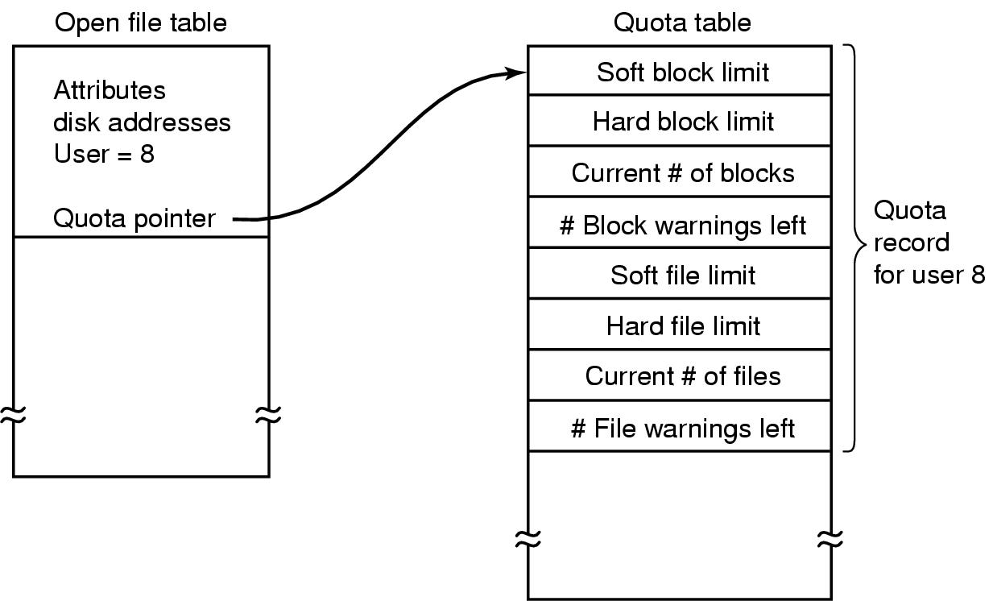
Disk Quotas
Figure 4-24. Quotas are kept track of on a per-user basis
in a quota table.
Tanenbaum, Modern Operating Systems 3 e, (c) 2008 Prentice-Hall, Inc. All rights reserved. 0-13-6006639

Slide 72
File System Backups (1)
Backups to tape are generally made to handle one of two potential problems:
Recover from disaster (e.g. disk crash, pit bull eats computer)
Recover from stupidity (e.g. pit bull removes file by stepping on keyboard)
Morale: (1)don’t allow pit bulls near computers (2) back up your files
Tapes hold hundreds of gigabytes and are very cheap
Tanenbaum, Modern Operating Systems 3 e, (c) 2008 Prentice-Hall, Inc. All rights reserved. 0-13-6006639

Slide 73
File System Backups (1)
Don’t want to back up whole file
  Can get binaries from manufacturer’s CD’s
  Temporary files don’t need to be backed up
  Special files (I/O) don’t need it
Tanenbaum, Modern Operating Systems 3 e, (c) 2008 Prentice-Hall, Inc. All rights reserved. 0-13-6006639

Slide 74
Back up Incrementally
Complete dump weekly/monthly and daily dump of modified files since big dump
=>to restore fs need to start with full dump and include modified files => need better algorithms
Problem-want to compress data before dumping it, but if part of the tape is bad…..
Problem-hard to dump when system is being used. Snapshot algorithms are available
Tanenbaum, Modern Operating Systems 3 e, (c) 2008 Prentice-Hall, Inc. All rights reserved. 0-13-6006639

Slide 75
Dumping strategies
Physical-dump the whole thing.
The good –it is simple to implement
Don’t want to dump
  unused blocks => program needs access to the unused block list and must write block number for used blocks on tape
  bad blocks. Disk controller must detect and replace them or the program must know where they are (they are kept in a bad block area by the OS)
Tanenbaum, Modern Operating Systems 3 e, (c) 2008 Prentice-Hall, Inc. All rights reserved. 0-13-6006639

Slide 76
Good vs Bad
The good-easy to implement
The bad
  Can’t skip a particular directory
  Can’t make incremental dumps
  Can’t restore individual files
Not used
Use logical dumps
Tanenbaum, Modern Operating Systems 3 e, (c) 2008 Prentice-Hall, Inc. All rights reserved. 0-13-6006639

Slide 77
Logical Dumps
Starts at directory and recursively dumps all files/directories below it which have changed since a given time
Examine standard algorithm used by Unix. Dumps files/directories on path to modified file/directory because
  Can restore path on different computer
  Have the ability to restore a single file
Tanenbaum, Modern Operating Systems 3 e, (c) 2008 Prentice-Hall, Inc. All rights reserved. 0-13-6006639

Slide 78
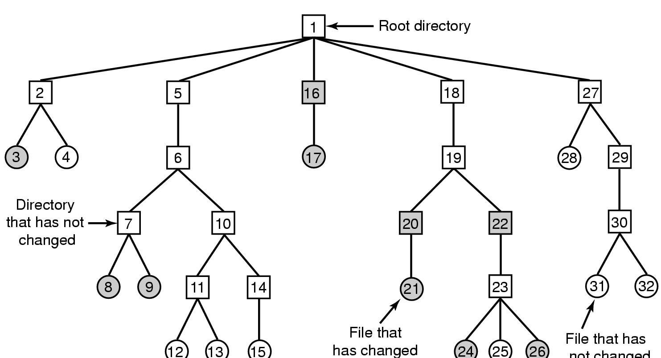
File System Backups
Figure 4-25. A file system to be dumped. Squares are directories, circles are files. Shaded items have been modified since last dump. Each directory and file is labeled by its i-node number.
Tanenbaum, Modern Operating Systems 3 e, (c) 2008 Prentice-Hall, Inc. All rights reserved. 0-13-6006639

Slide 79
Logical Dump Algorithm
Uses bitmap indexed by i-node
4 phases
Phase 1-starts at root and marks bits for modified files and all directories (a)
Phase 2-walks the tree, unmarks directories without modified files in/under them (b)
Phase 3-go through i-nodes and dump marked directories (c)
Phase 4-dump files (d)
Tanenbaum, Modern Operating Systems 3 e, (c) 2008 Prentice-Hall, Inc. All rights reserved. 0-13-6006639

Slide 80
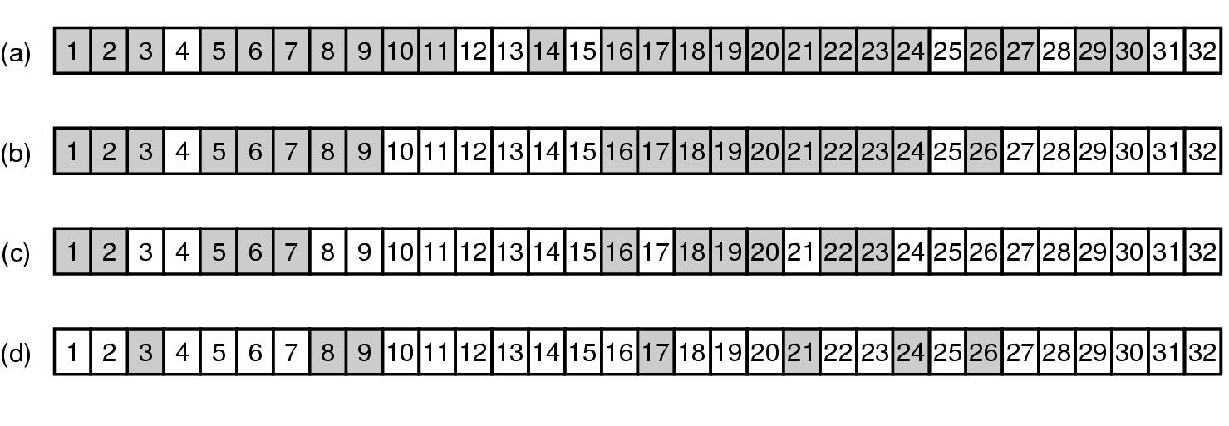
File System Backups
Bitmaps used by the logical dumping algorithm.
Tanenbaum, Modern Operating Systems 3 e, (c) 2008 Prentice-Hall, Inc. All rights reserved. 0-13-6006639

Slide 81
Restoring file on disk
Start with empty fs on disk
Restore most recent full dump. Directories first, then files.
Then do restore incremental dumps (they are in order on the tape)
Tanenbaum, Modern Operating Systems 3 e, (c) 2008 Prentice-Hall, Inc. All rights reserved. 0-13-6006639

Slide 82
Restoring file on disk-issues
Free block list must be reconstructed. Easy to do-it is the complement of the used blocks
Links to files have to be carefully restored
Files can have holes in them. Don’t want to restore files with lots of zeroes in them
Pipes can’t be dumped
Tape density is not increasing => need lots of tapes and robots to get at them. Soon will need disks to be the back-ups!!!
Tanenbaum, Modern Operating Systems 3 e, (c) 2008 Prentice-Hall, Inc. All rights reserved. 0-13-6006639

Slide 83
File System Consistency
Crash before blocks written out results in an inconsistent state=>
Need utility program to check for consistency in blocks and files
(fsck in Unix, scandisk in Windows)
Uses two tables
  How many times is block present in a file
  How many times block is present in free list
  Device then reads all of the i-nodes, increments counters
Tanenbaum, Modern Operating Systems 3 e, (c) 2008 Prentice-Hall, Inc. All rights reserved. 0-13-6006639

Slide 84
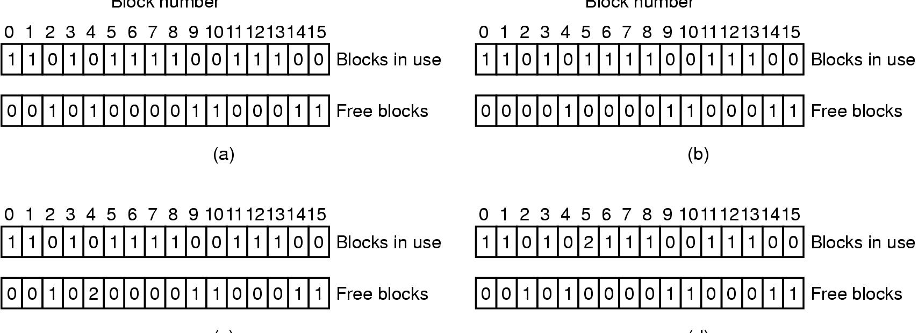
File System Consistency
Figure 4-27. File system states. (a) Consistent. (b) Missing block. (c) Duplicate block in free list. (d) Duplicate data block.
Tanenbaum, Modern Operating Systems 3 e, (c) 2008 Prentice-Hall, Inc. All rights reserved. 0-13-6006639

Slide 85
Solutions
Missing block (b)-put on free list
Block occurs twice on free list (c)-re-build free list
Block occurs twice on blocks in use (d)- notify user. (If one file is removed, then block appears on both lists)
Tanenbaum, Modern Operating Systems 3 e, (c) 2008 Prentice-Hall, Inc. All rights reserved. 0-13-6006639

Slide 86
File Consistency
Look at files instead of blocks
Use table of counters, one per file
Start at root directory, descend, increment counter each time file shows up in a directory
Compares counts with link counts from the i-nodes. Have to be the same to be consistent
Tanenbaum, Modern Operating Systems 3 e, (c) 2008 Prentice-Hall, Inc. All rights reserved. 0-13-6006639

Slide 87
File System Performance
Read word from memory: 32 nsec
Disk: 5-10 msec seek + 100 MB/sec transfer
Cache blocks in memory
Hash table (device, disk address) to manage
Need algorithm to replace cache blocks-use paging algorithms, e.g LRU
Tanenbaum, Modern Operating Systems 3 e, (c) 2008 Prentice-Hall, Inc. All rights reserved. 0-13-6006639

Slide 88
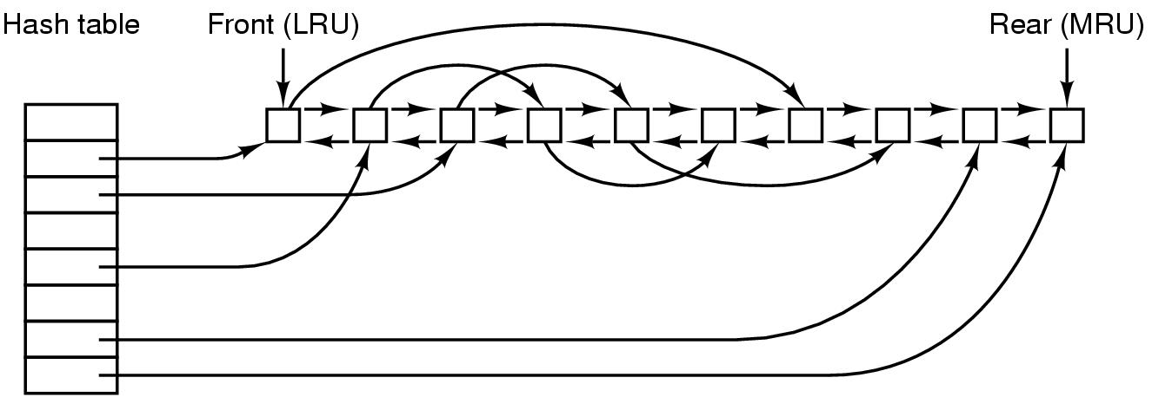
Caching (1)
Figure 4-28. The buffer cache data structures.
Tanenbaum, Modern Operating Systems 3 e, (c) 2008 Prentice-Hall, Inc. All rights reserved. 0-13-6006639

Slide 89
Replacement
Problem with LRU-some blocks are infrequently used, but have to be in memory
i-node-needs to be re-written to disk if modified. Crash could leave system in inconsistent state
Modify LRU
  Is block likely to be used again?
  Is block essential to consistency of file system?
Tanenbaum, Modern Operating Systems 3 e, (c) 2008 Prentice-Hall, Inc. All rights reserved. 0-13-6006639

Slide 90
Replacement
Use categories-i-nodes,indirect blocks, directory blocks,full data blocks,partial data blocks
Put ones that will be needed at the rear
If block is needed and is modified, write it to disk asap
Tanenbaum, Modern Operating Systems 3 e, (c) 2008 Prentice-Hall, Inc. All rights reserved. 0-13-6006639

Slide 91
Replacement
In order to put modified blocks on disk asap
  UNIX sync-forces all modified blocks to disk. Issued every 30 secs by update program
  Windows-modify block, write to disk immediately (Write through cache)
Tanenbaum, Modern Operating Systems 3 e, (c) 2008 Prentice-Hall, Inc. All rights reserved. 0-13-6006639

Slide 92
Block read ahead
Block read-ahead-if read in block k to cache, read in k+1 if it is not already there
Only works for sequential files
Use a bit to determine if file is sequential or random. Do a seek, flip the bit.
Tanenbaum, Modern Operating Systems 3 e, (c) 2008 Prentice-Hall, Inc. All rights reserved. 0-13-6006639

Slide 93
Reducing arm motion
Try to put blocks which are to be accessed sequentially close to one another.
Easy to do with a bitmap in memory, need to place blocks consecutively with free list
    Allocate storage from free list in 2 KB chunks when cache blocks are 1 KB
  Try to put consecutive blocks in same cylinder
i-nodes-place them to reduce seek time (next slide)
Tanenbaum, Modern Operating Systems 3 e, (c) 2008 Prentice-Hall, Inc. All rights reserved. 0-13-6006639

Slide 94

i-nodes-Reducing Disk Arm Motion
Figure 4-29. (a) I-nodes placed at the start of the disk.
(b) Disk divided into cylinder groups, each with its own blocks and i-nodes.
Tanenbaum, Modern Operating Systems 3 e, (c) 2008 Prentice-Hall, Inc. All rights reserved. 0-13-6006639

Slide 95
Defragging Disks
In the beginning, files are placed contiguously on the disk
Over time holes appear
Windows defrag program to puts together disparate blocks of a file
Linux doesn’t get as many holes
Tanenbaum, Modern Operating Systems 3 e, (c) 2008 Prentice-Hall, Inc. All rights reserved. 0-13-6006639

Slide 96
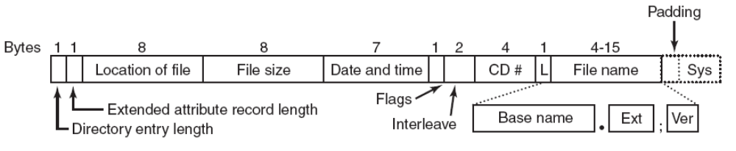
The ISO 9660 File System
Figure 4-30. The ISO 9660 directory entry.
Tanenbaum, Modern Operating Systems 3 e, (c) 2008 Prentice-Hall, Inc. All rights reserved. 0-13-6006639

Slide 97
Rock Ridge Extensions
Rock Ridge extension fields:
PX - POSIX attributes.
PN - Major and minor device numbers.
SL - Symbolic link.
NM - Alternative name.
CL - Child location.
PL - Parent location.
RE - Relocation.
TF - Time stamps.
Tanenbaum, Modern Operating Systems 3 e, (c) 2008 Prentice-Hall, Inc. All rights reserved. 0-13-6006639

Slide 98
Joliet Extensions
Joliet extension fields:
Long file names.
Unicode character set.
Directory nesting deeper than eight levels.
Directory names with extensions
Tanenbaum, Modern Operating Systems 3 e, (c) 2008 Prentice-Hall, Inc. All rights reserved. 0-13-6006639

Slide 99
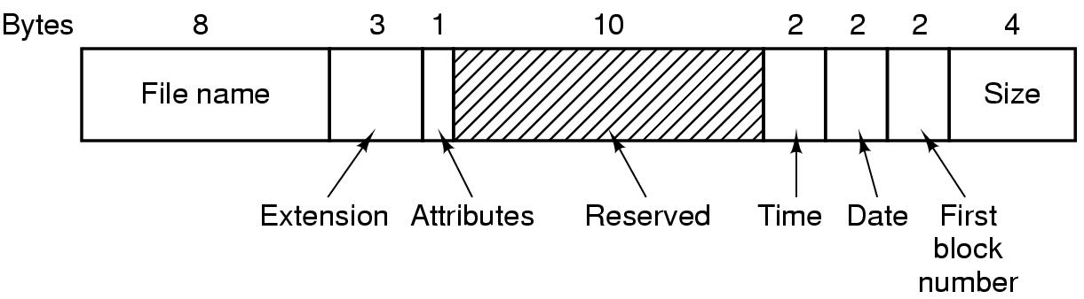
The MS-DOS File System-directory entry
.
Tanenbaum, Modern Operating Systems 3 e, (c) 2008 Prentice-Hall, Inc. All rights reserved. 0-13-6006639

Slide 100
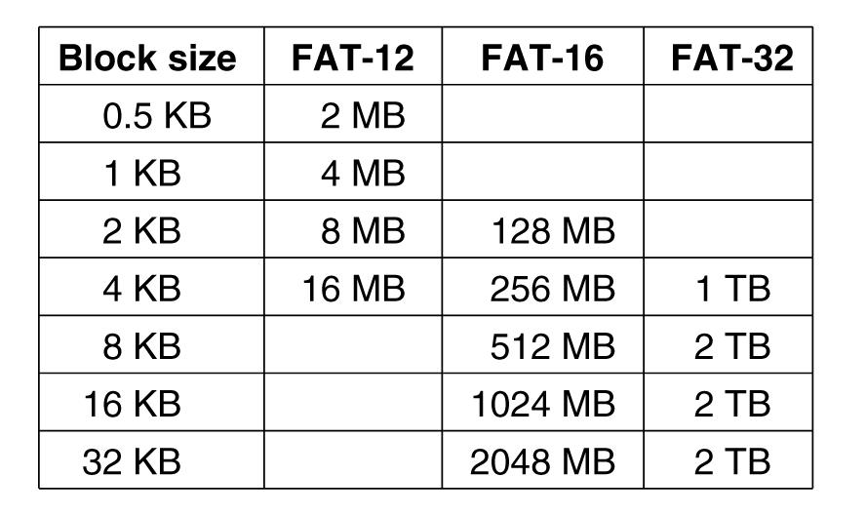
The MS-DOS File System –maximum partition size
Figure 4-32. Maximum partition size for different block sizes. The empty boxes represent forbidden combinations.
Tanenbaum, Modern Operating Systems 3 e, (c) 2008 Prentice-Hall, Inc. All rights reserved. 0-13-6006639

Slide 101
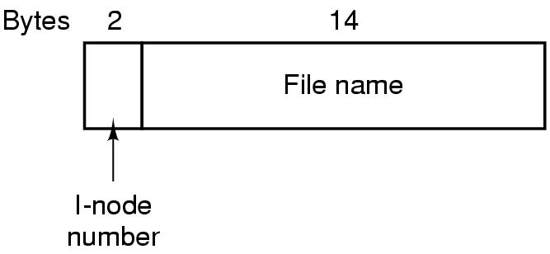
The UNIX V7 File System (1)
Figure 4-33. A UNIX V7 directory entry.
Tanenbaum, Modern Operating Systems 3 e, (c) 2008 Prentice-Hall, Inc. All rights reserved. 0-13-6006639

Slide 102
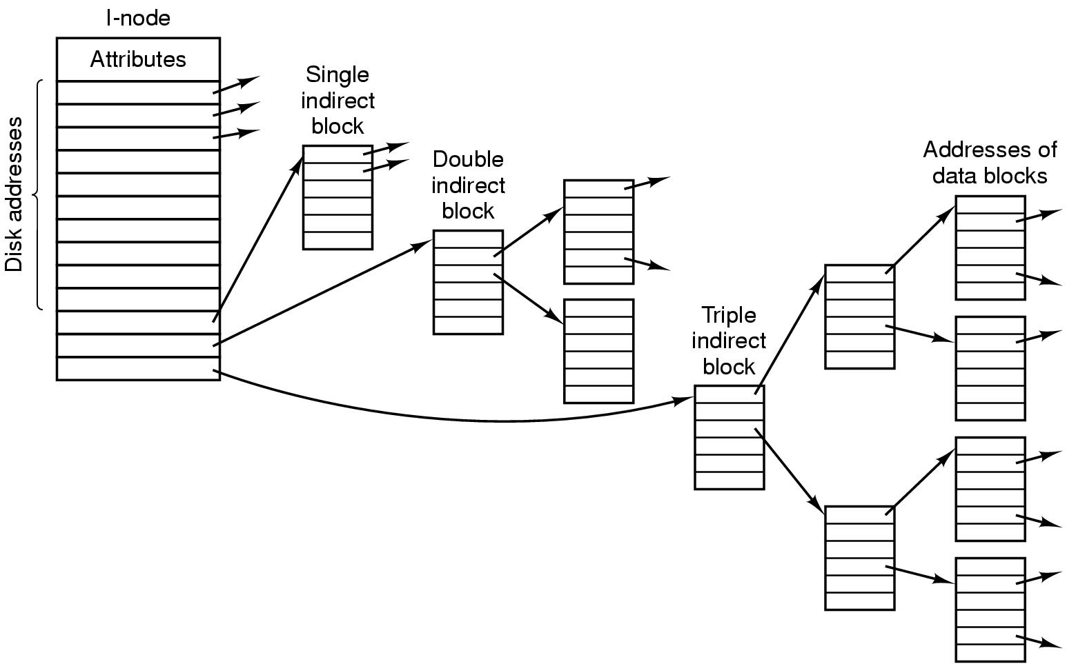
The UNIX V7 File System (2)
Figure 4-34. A UNIX i-node.
Tanenbaum, Modern Operating Systems 3 e, (c) 2008 Prentice-Hall, Inc. All rights reserved. 0-13-6006639

Slide 103
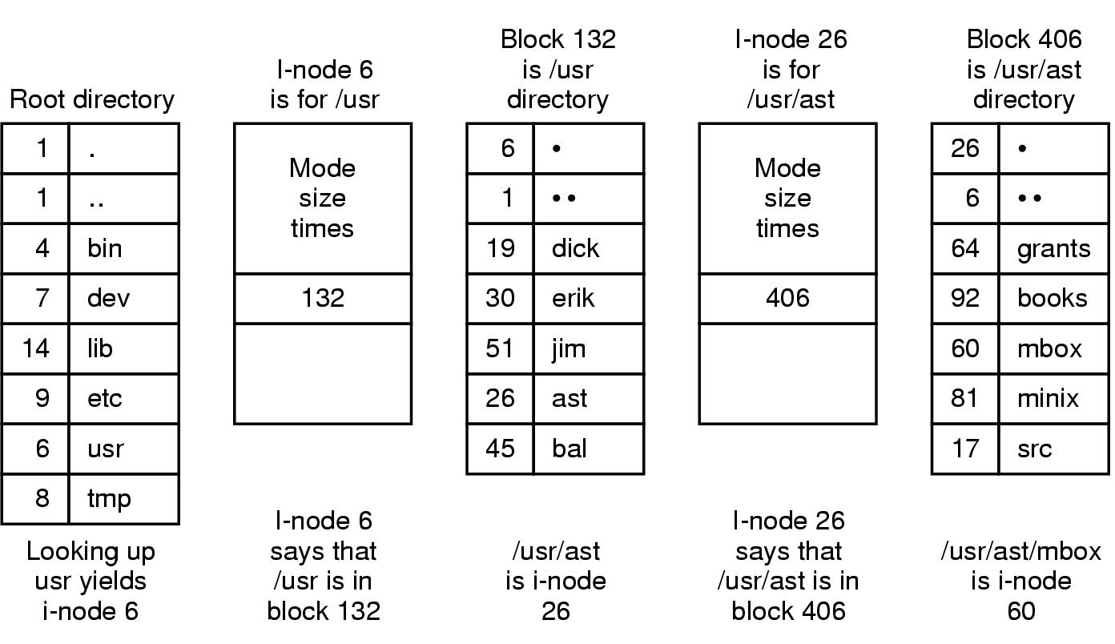
The UNIX V7 File System (3)
Figure 4-35. The steps in looking up /usr/ast/mbox.
Tanenbaum, Modern Operating Systems 3 e, (c) 2008 Prentice-Hall, Inc. All rights reserved. 0-13-6006639

